Slide 1
Opening Your Doors: Recruitment, Screening, and Orientation in Distance and Blended Learning
IDEAL Consortium Handbook Series Webinar 2
Notes:
Opening Your Doors: Recruitment, Screening, and Orientation in Distance and Blended Learning Programs (Webinar)
Early research on learner success in distance learning for adult basic education elucidated the importance of finding learners for whom distance was a good fit and then dedicating resources to ensure a thorough orientation. The expansion of educational technology commonly used today to support blended learning requires a different lens for thinking about recruitment, screening, and orientation. In this Tech ‘n Tell webinar, the second in a series of three on distance and blended learning, we provide guidance for determining characteristics of learners for whom distance and blended learning are a good fit, getting them in the door, and then figuring out how to best support their engagement in learning. The webinar will feature past research and first-hand experience from work done within the IDEAL Consortium.

Slide 2
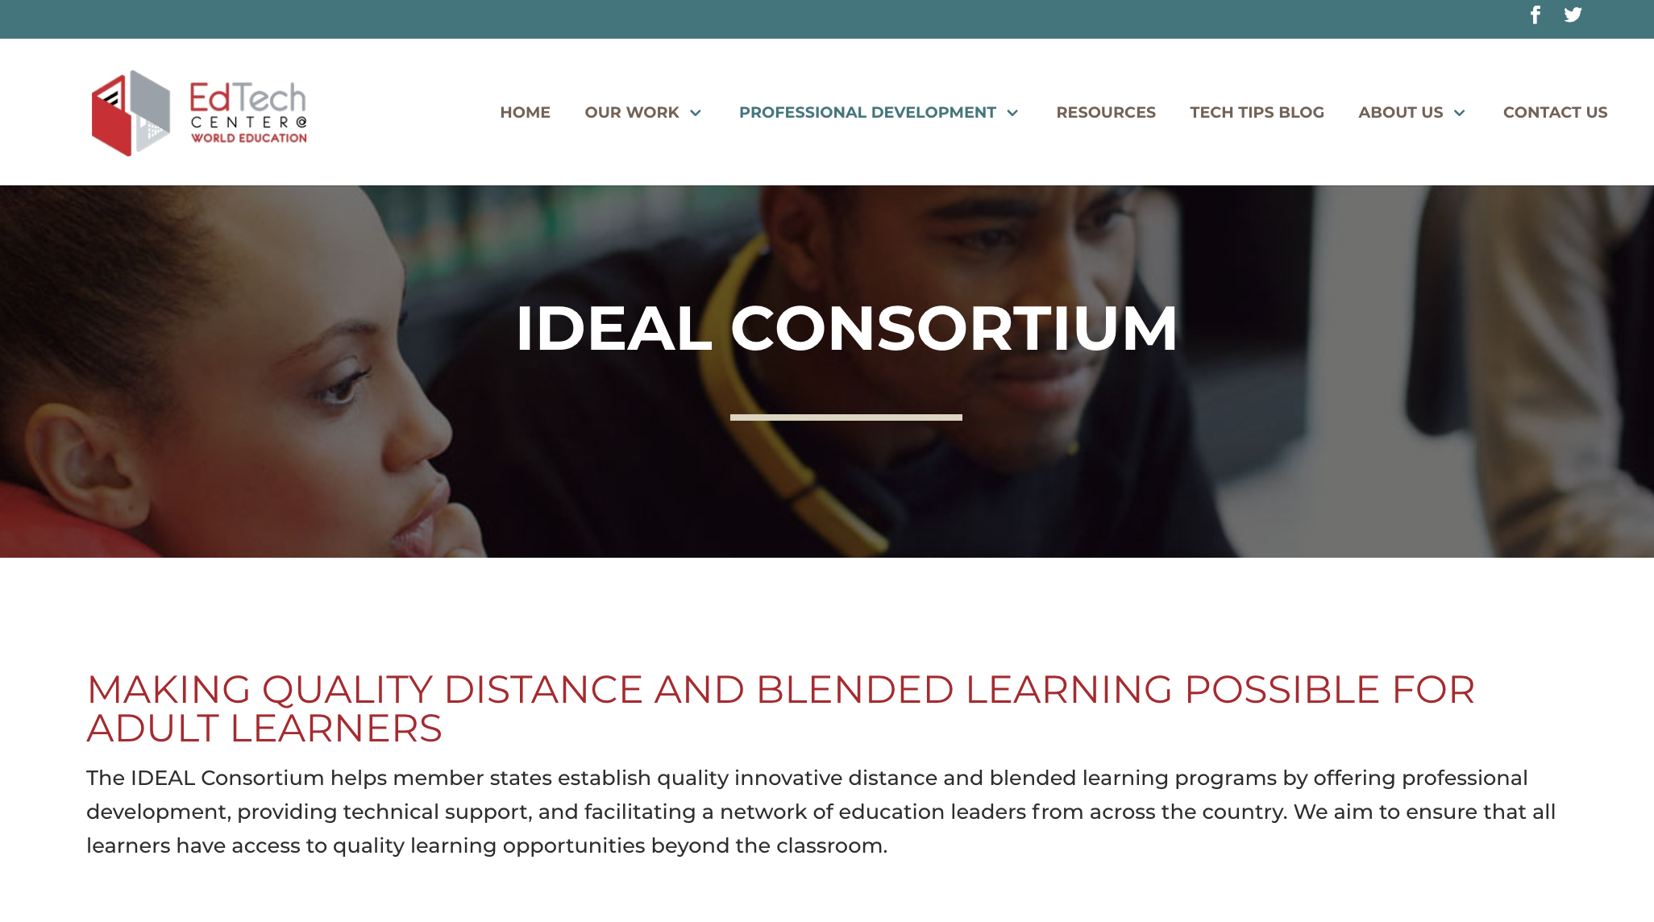
Notes:
The work is gleaned from over a decade of providing technical support and professional development to practitioners initiating or enhancing quality DL and BL programs. The work is through the IDEAL Consortium. SABES is a partner in this work in Massachusetts - IDEAL present in many other states, too

Slide 3
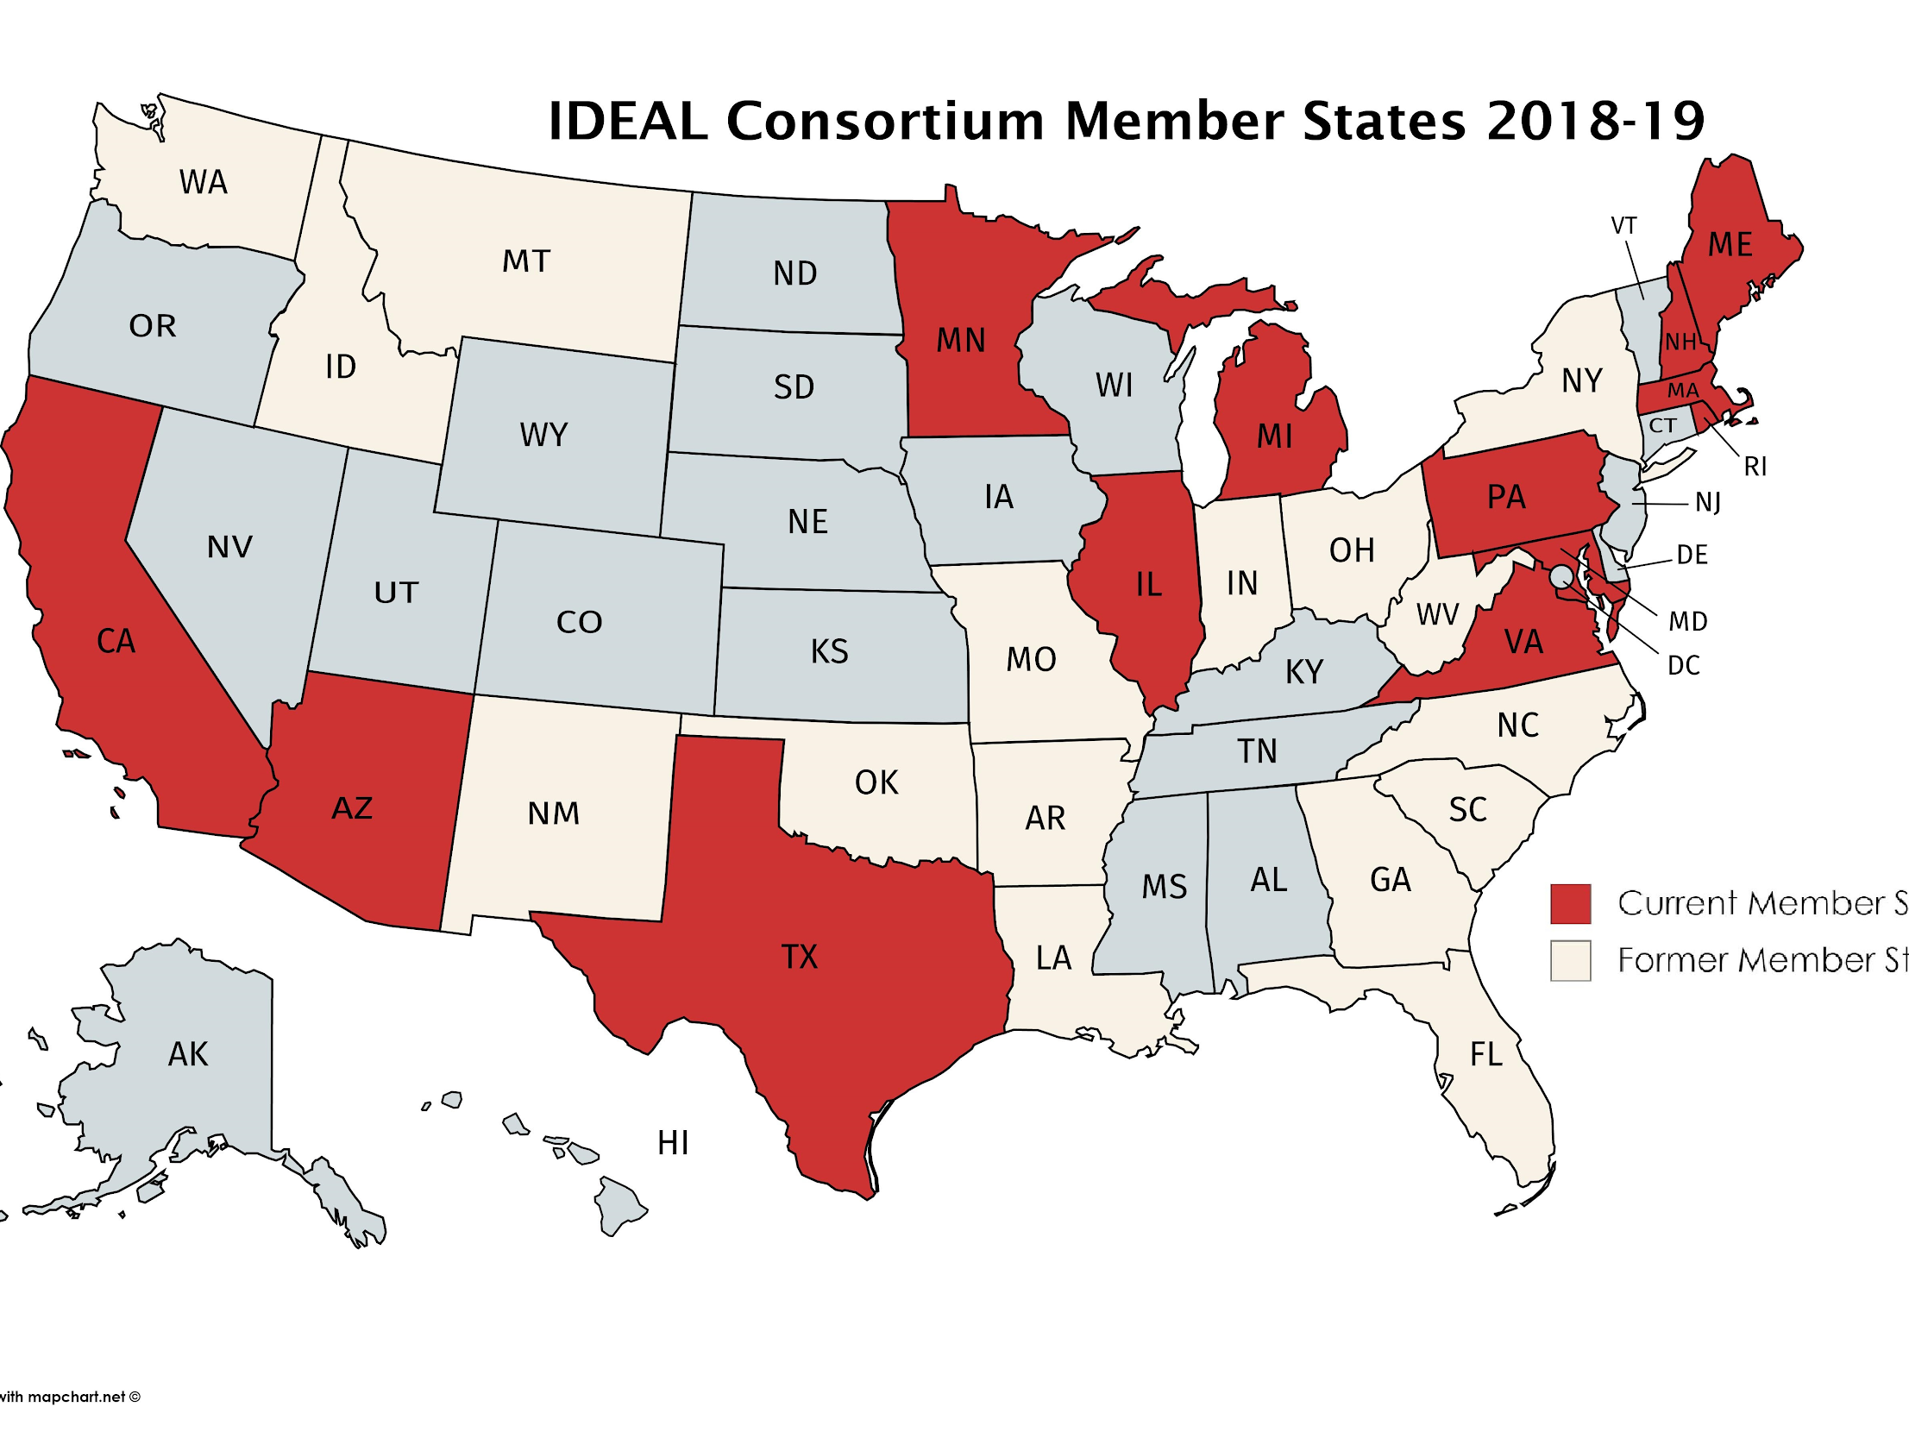
Jen_Vanek@WorldEd.org
Director of Digital Learning & Research
EdTech Center @ World Ed

Slide 4
Agenda
Who’s here?
Foundational Research
Key areas of implementation
Examples from different states
How to make it work: Key findings from IDEAL Consortium research

Slide 5
Who’s here?
Teacher
Researcher
State ABE staff
Teacher educator
Program administrator
Technologist specialist
Notes:
POLL – choose one

Slide 6
Read the blog post
https://edtech.worlded.org/support-distance-learners-from-the-start/
Notes:
THIS IS THE FIRST OF A SERIES OF THREE WEBINARS BASED ON THREE BLOG POSTS

Slide 7
Evidence-based approach
Foundational Research
Early research showed persistence improved when programs identify learners they are best situated to support and then orient them to DL
Petty & Johnston, 2002
Askov, Johnston, Petty & Young, 2003;
Petty, 2005
Recent Research
Efforts to initiate use of online tools support persistence down the road.
Sharma, Vanek, & Webber, 2019
Adult Literacy XPRIZE Communities Competition
Notes:
Early research literature on distance learning in adult education in the US first illustrated the importance of finding the right students and setting them up correctly if programs were to succeed in offering distance education (Petty & Johnston, 2002; Askov, Johnston, Petty & Young, 2003; Petty, 2005). A strong start is still understood to be a key initial effort needed to support persistence. Indeed, a smooth start is considered so critical today that developers have taken note and endeavor to minimize the difficulty of onboarding of new students to their ed tech. (Sharma, Vanek, & Webber, 2019)

Slide 8
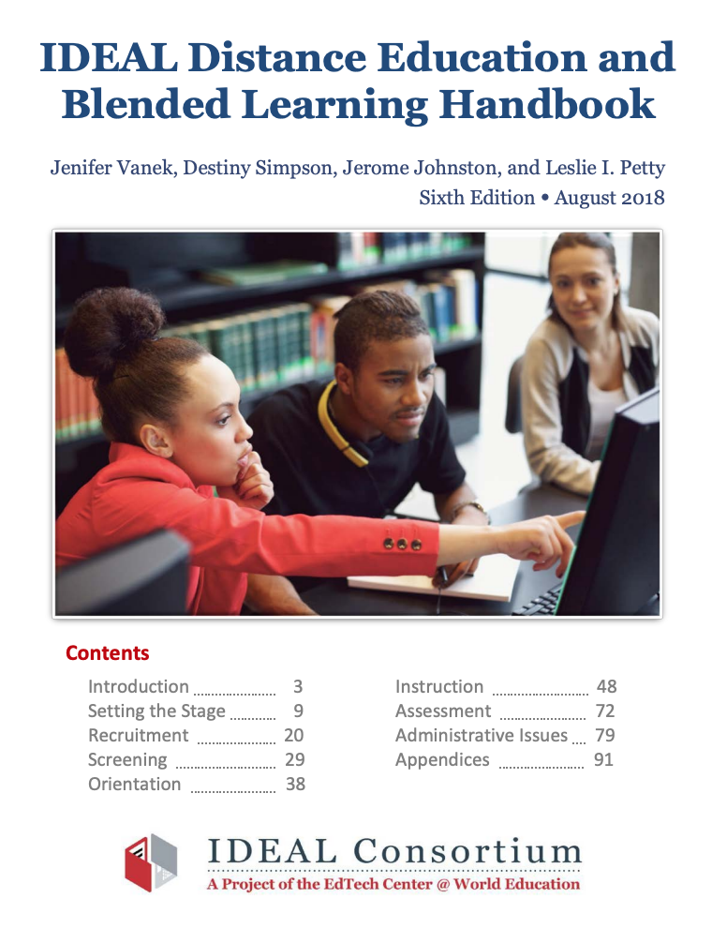
Implementation Areas
Recruitment: Identifying and Recruiting Students
Decide who, where, and how to find learners for DL program
Screening: Determining Who Is Ready for DL & BL Identify which learners you can successfully support and who meet your criteria for participation
Orientation: Setting Up Learners for Success
Design an orientation that provides students with the necessary information and skills for a successful learning experience and a plan for reaching goals
Notes:
Examination of topics helps participants design DL implementation plan based on b
http://mnabe-distancelearning.org/resources/dl-implementation-resources-best-practicesest practices

Slide 9
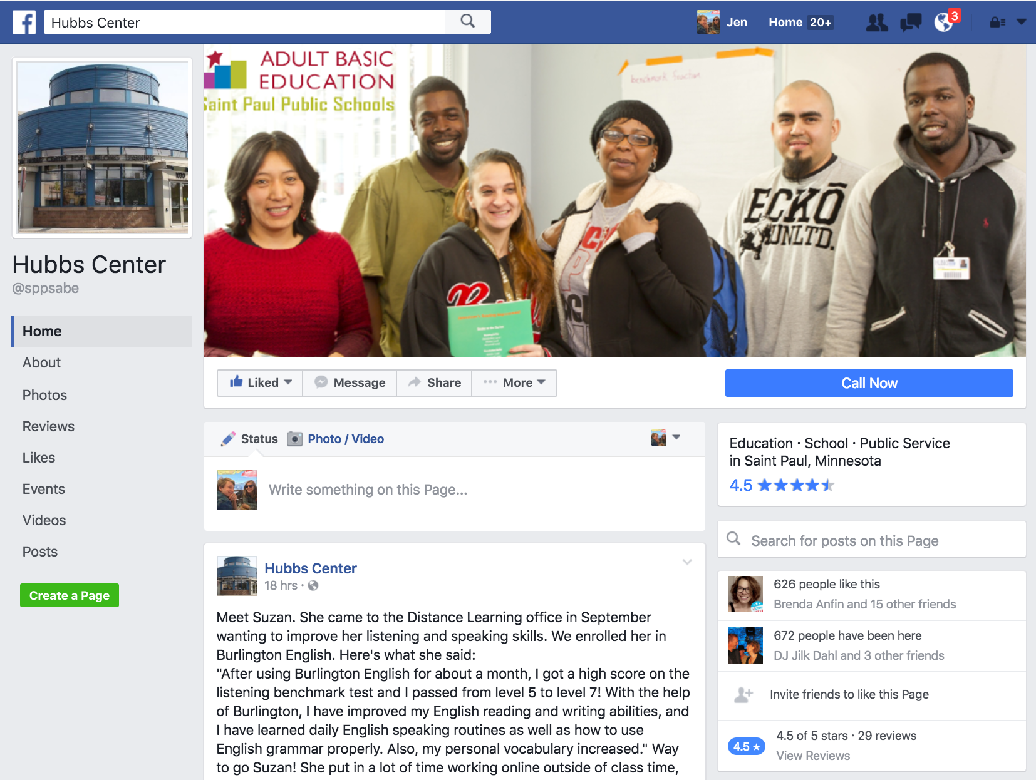
Recruitment
Decide who, where, and how to find learners for DL program
Think about a targeted learning opportunity. Consider the curricular and technology demands of your program.
Identify characteristics, skills, and proficiencies of a learner who would succeed.
Think about how you’ll reach them (e.g., fliers in public places, website, Facebook, partnerships with workforce development agencies).
Notes:
Will you deliver strictly distance options? Will you attempt to provide blended learning opportunities? The programming you want to create and the type of learner you suspect will persist determine who you recruit. Your decisions about this will rest on what you determine about your program goals and its capacity.
Take stock of the resources you can make available to learners.
Knowing who to recruit and understanding your means to support them go hand-in-hand. For example, if you know there is no capacity for offering access to computers and internet, do not recruit learners who lack home access unless your chosen curriculum is mobile friendly. If you are able to purchase a license for a core online curriculum, decide whether the product should be tailored to a particular group of students or one that serves a variety of learners with different educational needs. Recruit only those learners who fit the profile of that curriculum.
Identify the characteristics that will improve a learner’s chances of success.
Whether you are teaching in a blended, hybrid, or distance format, successful students are likely to be self-motivated, able to work independently, and possess strong study and organizational skills. Additionally, they have access to the technologies required to participate in learning and sufficient digital literacy to solve problems that arise as they learn.
Decide where to recruit for new students.
Recruiting in classrooms. For blended learning, it is often best to start recruiting with your current students. Because they are known, teachers will have more information about whether they possess the characteristics described above.
Recruiting in the community. In the early days of adult education distance programming, programs conducted recruitment in the broader community using low tech approaches—flyers posted in libraries, community education centers, and restaurants frequented by English language learners. These methods are still useful, as are public service announcements or advertisements in local newspapers, public radio stations, and local cable channels. Also consider posting information about distance education on your website and in social media.
Students who find you through these websites have at least sufficient mastery of the technology needed to find you online. Providing an application form on a website can serve as a way for such a learner to contact your distance education program administrator and also demonstrates adequate digital literacy skills for online learning.
Recruiting within workforce development and other partner organizations.
The Workforce Innovation and Opportunity Act (WIOA) offers motivation for collaboration with workforce development partners, including shared outcomes and a no wrong door approach spelled out in WIOA. Also important is a shared imperative to use technology to help adult learners and job seekers better prepare for careers and further education. Reach out to partners and ask them if they will link to online information about your program on their websites. Make sure job counselors know about your distance options so they can refer learners to you.

Slide 10
Screening
Learner’s skills
Identify which learners you can successfully support; those who meet your criteria for participation
Academically prepared for the curriculum
Adequate technology skills
Soft-skills/Habits of Mind to support independent, goal driven work
Logistical readiness – time and place to do the work
Support available
Tech demands
Silver-Pacquilla and Reder’s (2008)
Notes:
After you have recruited – you need to determine who is actually ready. You will have learners respond who cannot yet succeed given the resources you have available. You need to decide the threshold of skill above which you can provide support. It is very easy to say yes to everyone. Results in a churn of orienting learners who cannot persist.

Slide 11
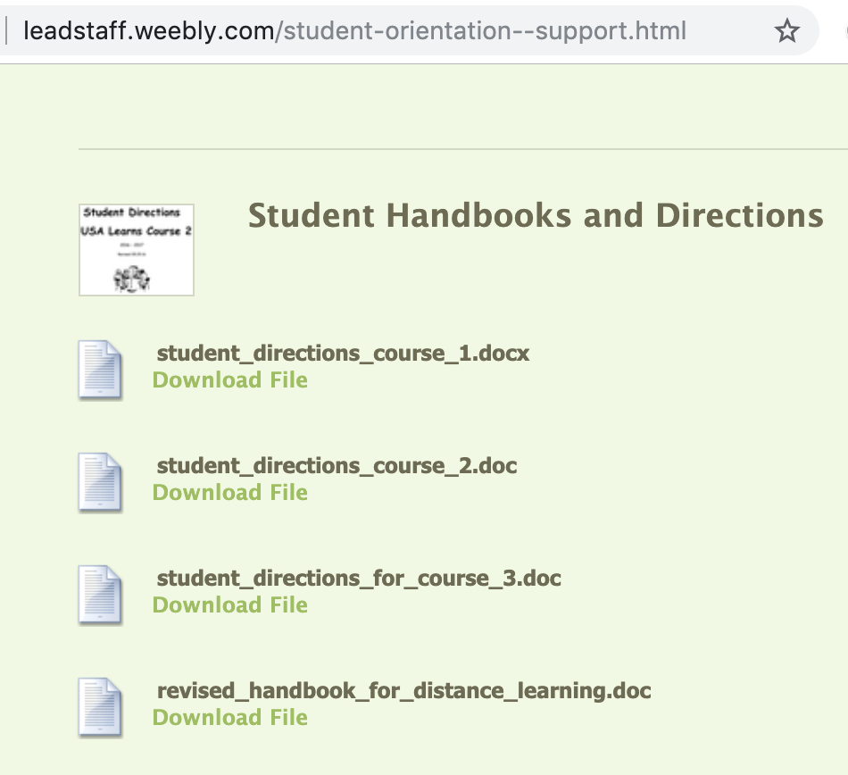
Orientation
Design an orientation that provides students with information and skills for a successful learning experience; include a plan for reaching goals
Goals & planning
Orient to curricula/course
Notes:
Animation here.. three examples

Slide 12
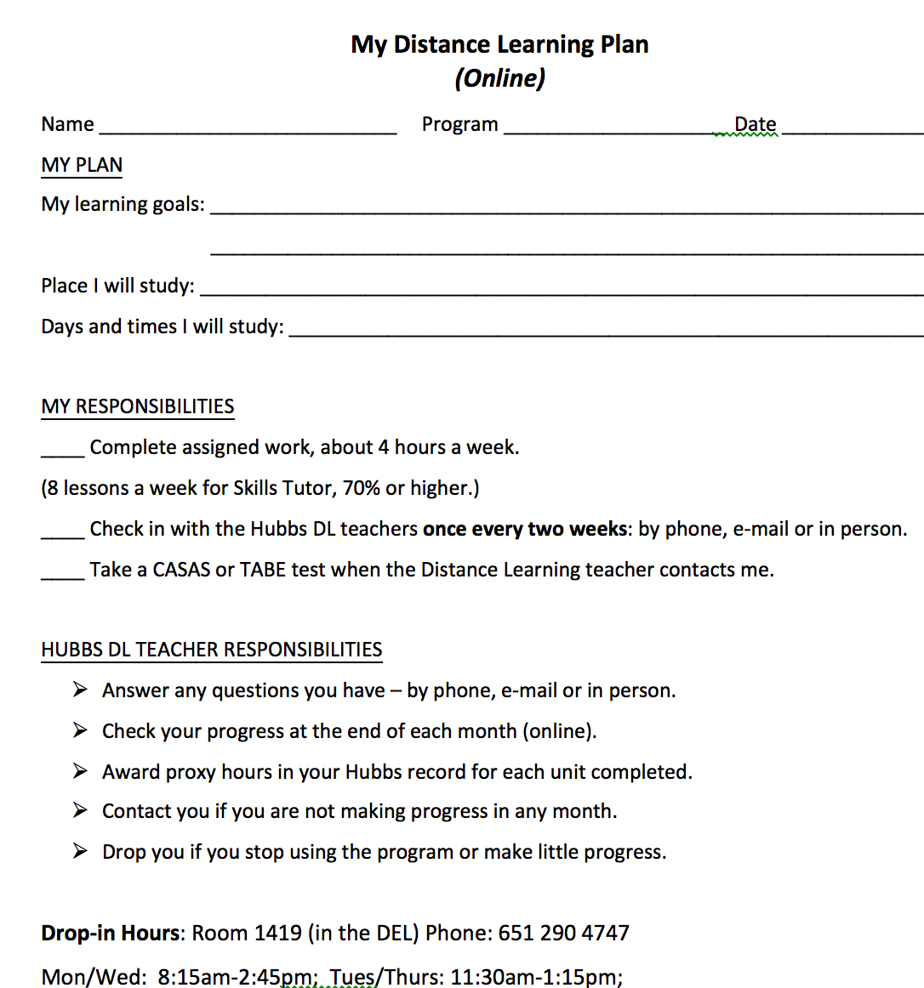
Orientation resource examples

Slide 13
What are you doing in these areas?
Recruitment | Orientation | Screening

Slide 14
Next webinars
This series of three, one-hour webinars is offered on Wednesdays from 10:00 a.m.—11:00 a.m.
Assessment and Instruction in Distance and Blended Learning Programs (June 19)
Notes:
Examination of topics helps participants design DL implementation plan based on b
http://mnabe-distancelearning.org/resources/dl-implementation-resources-best-practicesest practices

Slide 15
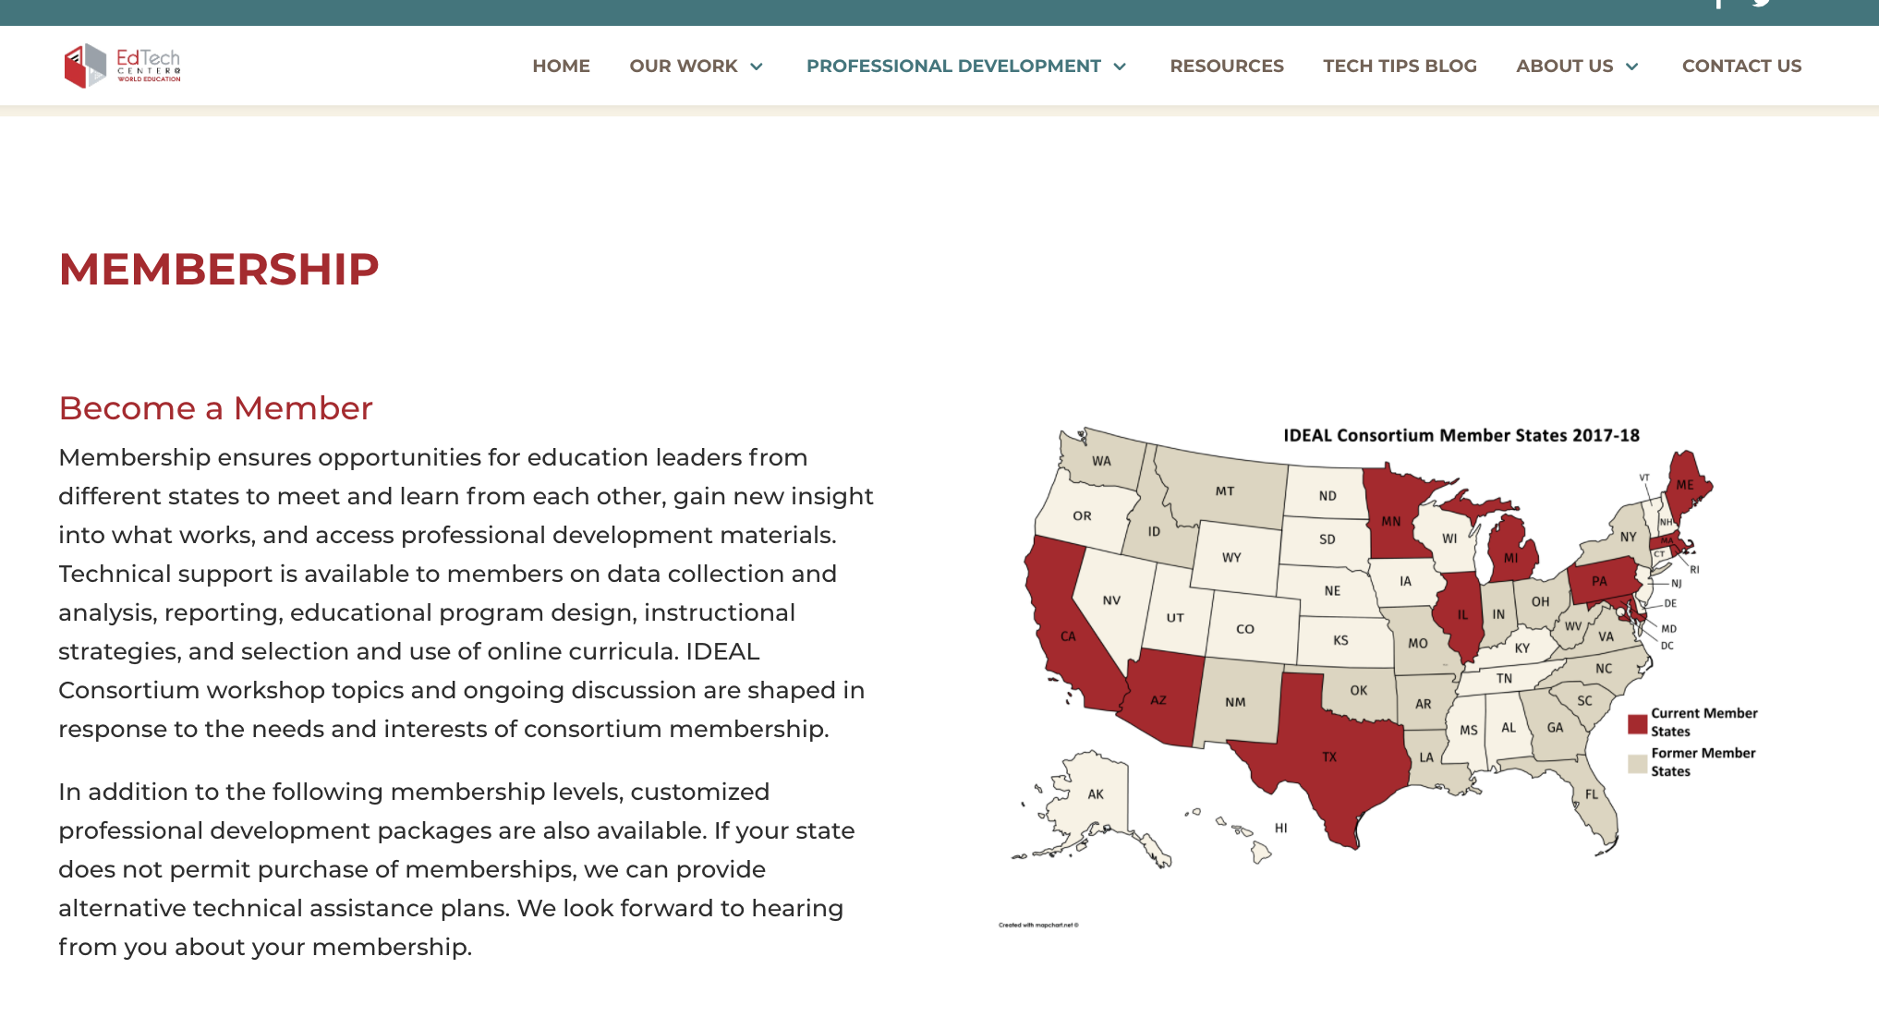
How can we help?
https://edtech.worlded.org/professional-development/ideal-consortium/

