Slide 1







#NIIC2017
Promoting Adult Education, Workforce Skills, and Civic Engagement
through Digital Learning
Notes:
ALISON- Welcome-

Slide 2


Increase Reach
Improve Outcomes
Why Technology?
Accelerate & Expand Learning
36 million
need literacy help in the U.S.
Increase
Opportunities & Advancement
32 million
will NOT
get help
Data from OECD.org (PIACC)
Notes:
ALISON

Slide 3

Potential (& Risk) of Technology
Anytime, Anywhere Learning
Accelerate, Extend & Expand Learning
Personalized Learning & Coaching
by level
by interest
by demographic (age, refugee, etc.)
by geography
by language (scalable, bilingual support), etc.
Scaled screening & Referrals
Competency-Based Digital Assessments
Digital Portfolios/ Micro-badging
Job Placement
Breaking down of Silos between Service Providers
Need to break down silos in curriculum/ programming to infuse tech
www.edtech.worlded.org/resource-list/
Notes:
ALISON

Slide 4
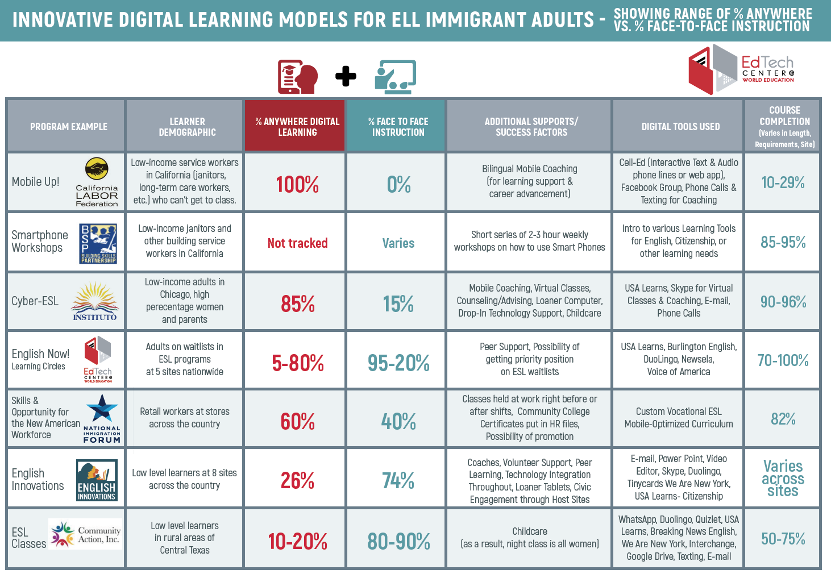

Slide 5

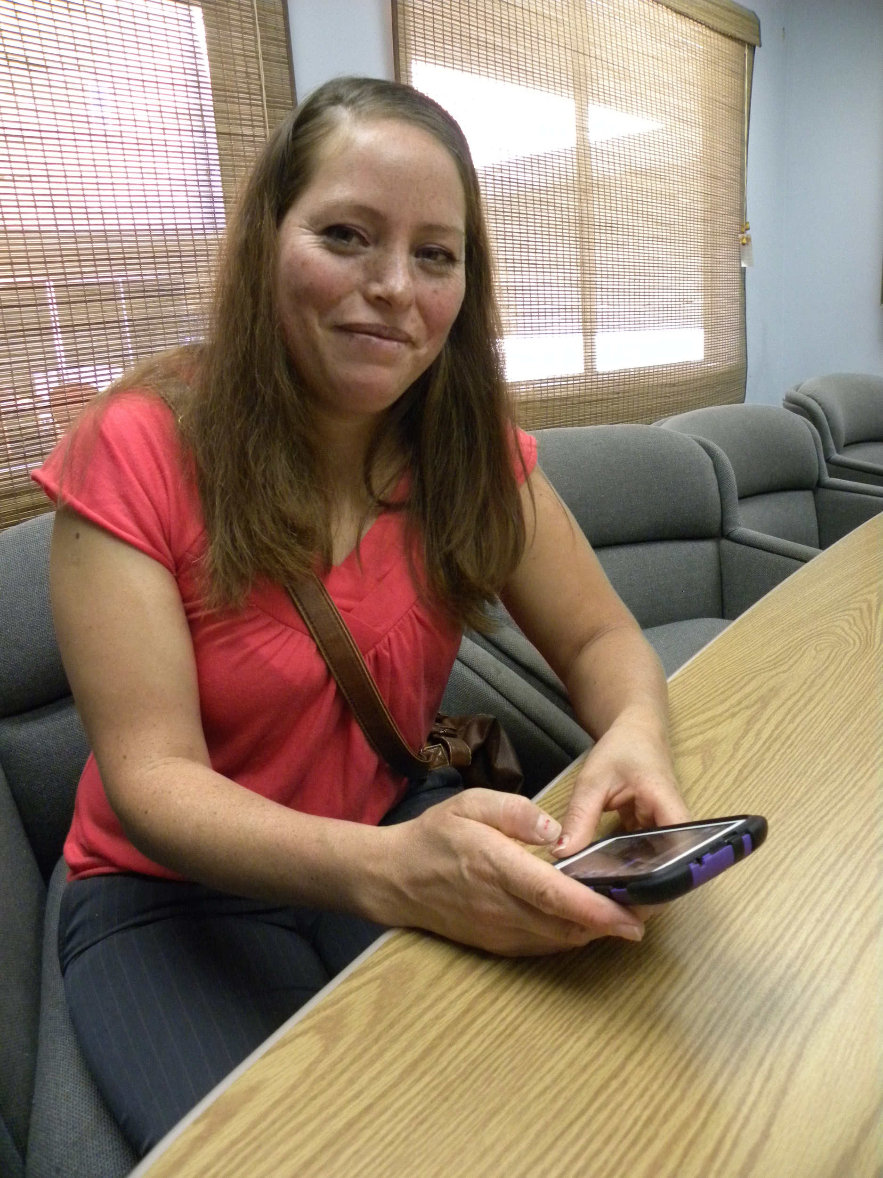


Mobile Up!
Designed for:
ELL immigrant service workers in California
Primarily SEIU union janitors (Building Skills Partnership)
and long-term care workers (California Long-Term Care
Education Center)
Notes:
ALISON

Slide 6
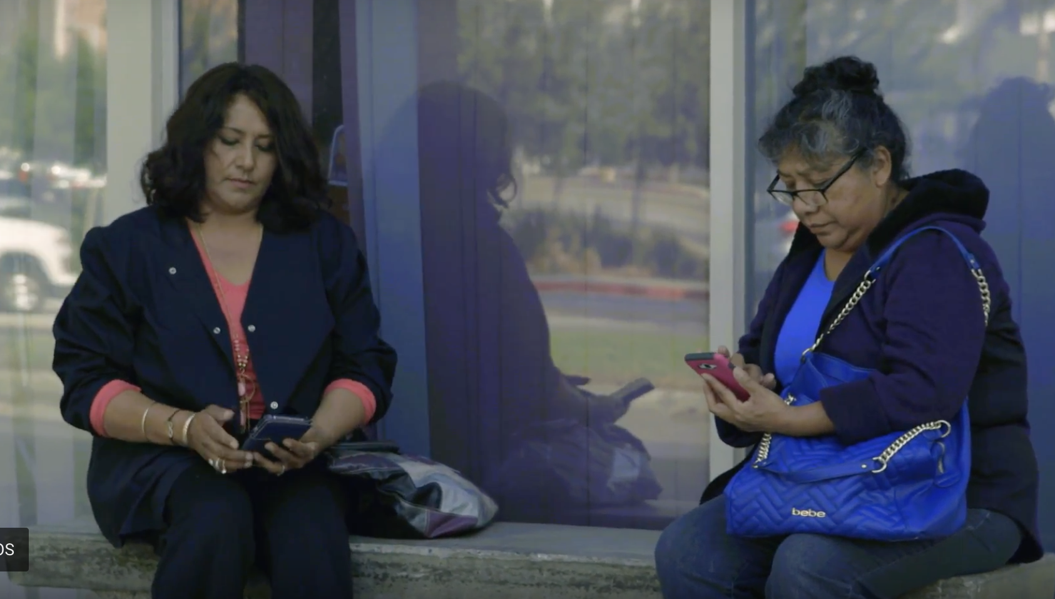
Mobile Up!
Course Completion: 10-29%
Key Components:
mLearning on Simple & Smart phones through Cell-Ed
Mobile, bilingual coaches to support learning & career education
Even 10% completion of 350,000 would be 35,000 building service & long-term care workers
Notes:
ALISON

Slide 7
Smart Phone
Workshop Series
Designed for:
Janitors and other building service workers across California
Often juggling multiple jobs → need flexible (short-term) training
Smartphone owners → but lack knowledge/confidence on using them
Notes:
ALISON

Slide 8
Smart-Phone Workshop Series
Key Components:
In-person instruction
Short (2- to 3-week) sessions and long (8-week) sessions
  2- to 3-week sessions: two hours a week over two/three weeks (4 to 6 hrs of total training)
  8-week sessions: two hours a week over eight weeks
(16 hrs of total training)
Notes:
ALISON

Slide 9
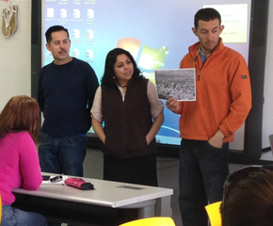
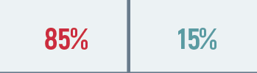
Cyber-ESL
Designed for:
Latino Adults in Chicago with some previous ESL studies, but unable to attend classes everyday.
65% women; Majority Parents and single parents
Notes:
ALISON

Slide 10
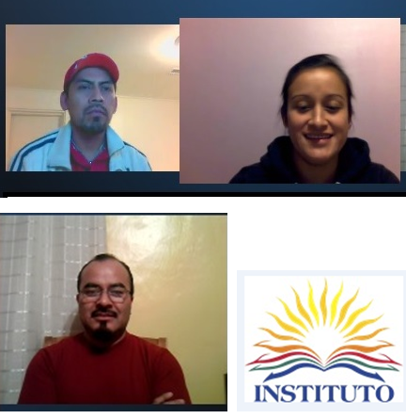
Cyber-ESL
Course Completion: 90-96%
Components:
USA Learns on line
Phone calls, emails, and Skype calls from Instructor
Mobile Instructor and Advisors
Face to Face session on site 2x Month
Program provided internet access and loaned computers
Drop in support for technology, advising, child care for face to face
Notes:
ALISON

Slide 11
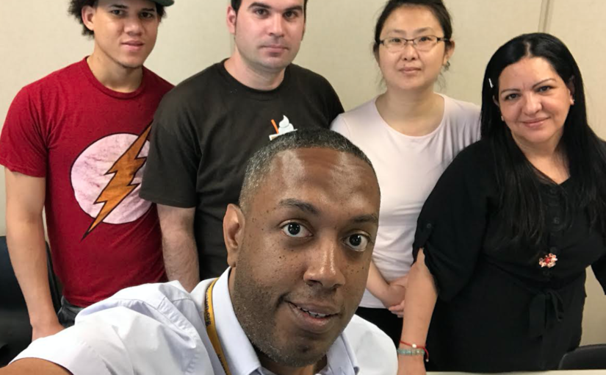
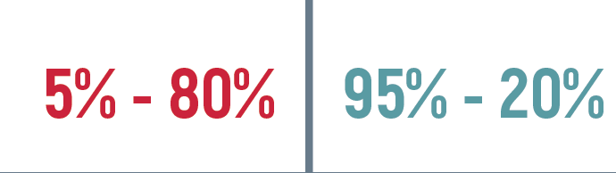
English
Now!
Designed for:
Adults on ESL waiting lists at adult schools, libraries, CBO’s across the country
Model for adults who can attend class meetings once a week
Model for leveraging volunteers
Notes:
ALISON

Slide 12
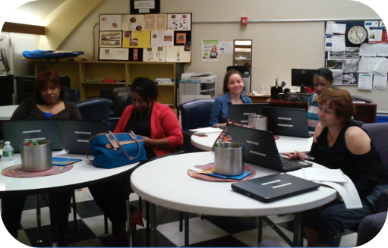
English Now!
Course Completion: 70-100%
Key Components:
Facilitated, informal learning circles run 6-12 weeks
Weekly meetings range from 1.5-2 hours
Meetings include independent online learning and group discussion
Peer learning (Peer to Peer University - P2PU.org)
Notes:
ALISON

Slide 13



Skills & Opportunity for the New American Workforce
Designed for:
Immigrant retail workers across the country
Meet needs of learner and company operations by offering blended learning
Partnering with leading employers on immigrant integration
Notes:
ALISON

Slide 14

Skills & Opportunity for the New American Workforce
Course Completion: 82%
Key Components:
Contextualized ESL for retail industry frontline workers
Classes held at worksites right before or after work-shifts
In only 3 months, 37% of workers reported job promotions
89% of managers’ ratings indicated improved store productivity
Notes:
ALISON

Slide 15
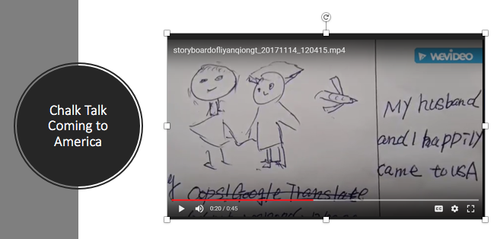
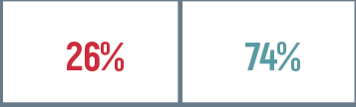
English Innovations
Designed for
100-hours jumpstart for beginning level ELLs
For parents, workers, community members
Telling and sharing digital stories
Students with little experience in formal learning
Students with limited time to spend in class
Groups that support linguistic, civic, and economic integration
Notes:
With an eye toward immigration reform - formal system cannot possibly absorb all students who may have to meet English requirements
Jump start and an onramp for further education

Slide 16
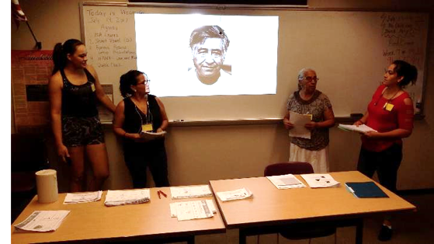
English Innovations
National program
(8 sites across
the U.S.)
Key Components:
Curriculum - flexible and adaptable to different groups and contexts
Integrates community engagement through curriculum and host sites
Emphasis on social learning (PBL)
English and technology “to get things done”
New emphasis on “Know Your Rights”
Extensive use of multimedia (video, audio, drawing)
High volunteer to student ratio
Notes:
Different contexts: onramp to workplace training, family literacy and citizenship:
Example: Carlos Rosario: Use EI model to help parents support the education of their children; students learn to navigate the schools website ; discuss what schools are and are not doing for their children - and practice the communication skills they need to community but also to adov
We looked at How People Learn - terrific research by the National Academy of science so we could create learning opportun that support the bilingual brain learning English

Slide 17

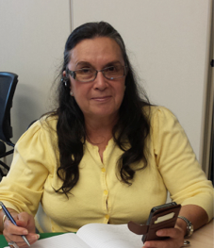

ESL Classes
Designed for:
Low skilled learners in rural Texas
Little experience with technology
Key component:
Childcare (as a result, night class is all women)
Notes:
ALISON

Slide 18
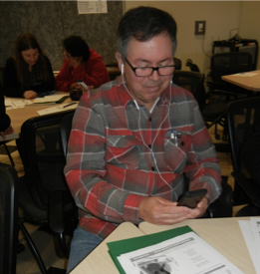
Community Action ESL Classes
Course Completion: 50-75%
Key components
Teacher highly skilled in technology
Creative solutions to technology challenges
Social cohesion through ongoing communication
Childcare (as a result, night class is all women)
Notes:
ALISON

Slide 19
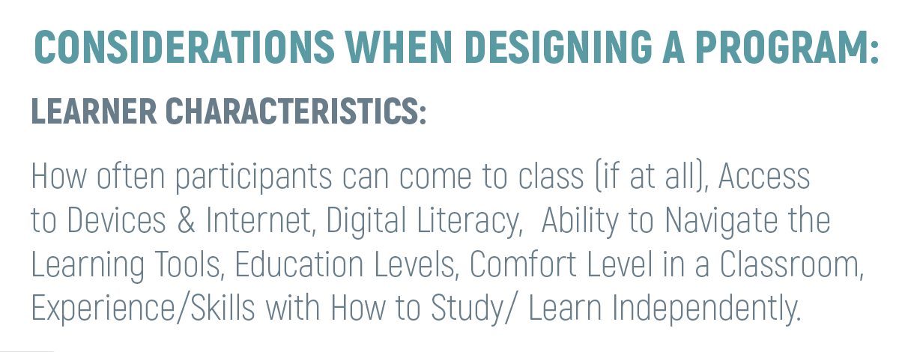
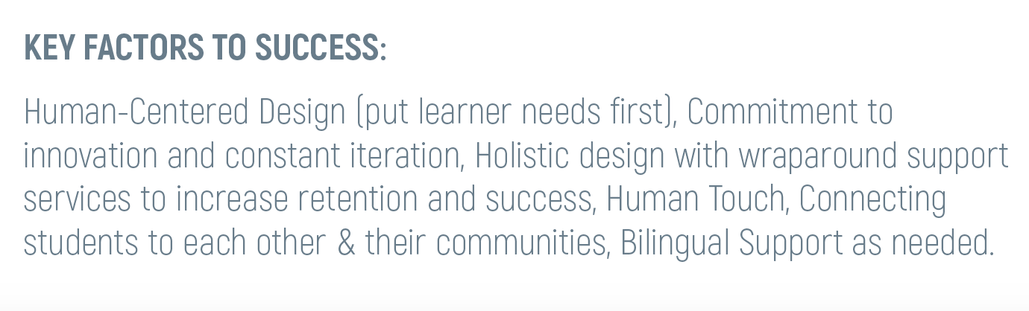
Considerations for Program Design
Notes:
ALISON

Slide 20
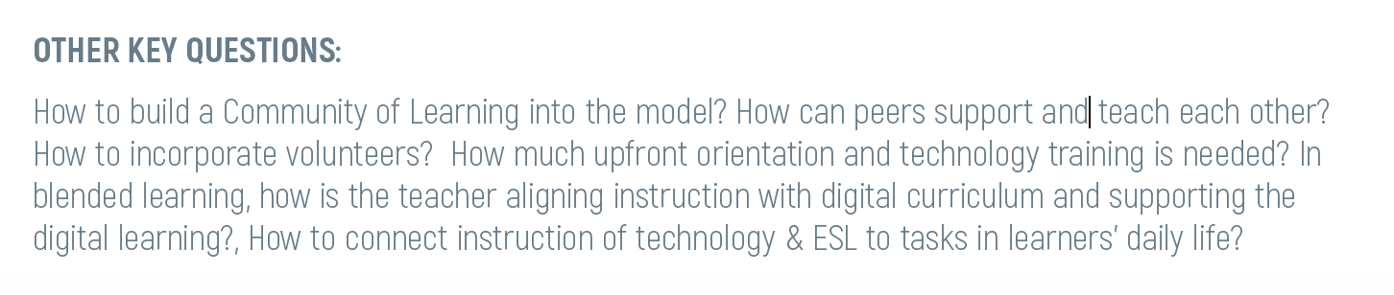
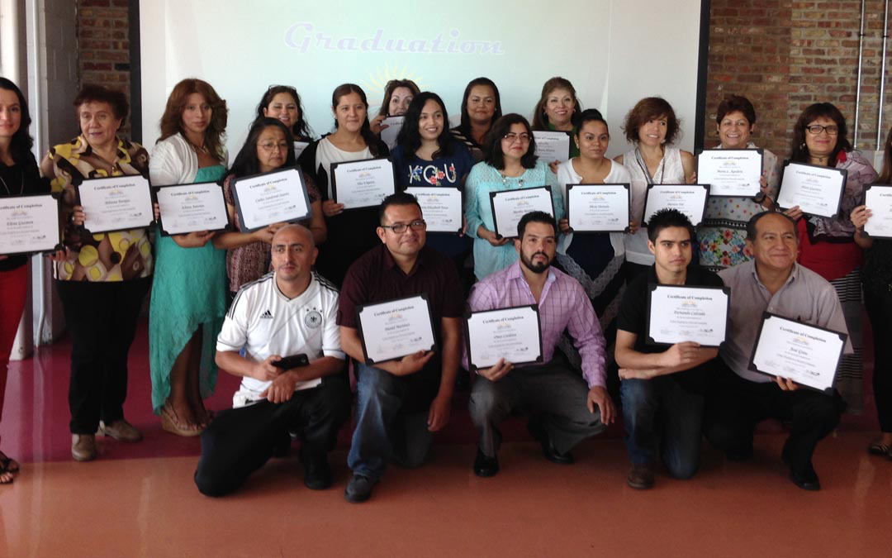
Notes:
ALISON

Slide 21

Policy / Funding Factors
How can policy and funding streams support such
Innovative program models for digital learning?
Notes:
ALISON

Slide 22
Question & Answer
Notes:
ALISON

