Slide 1
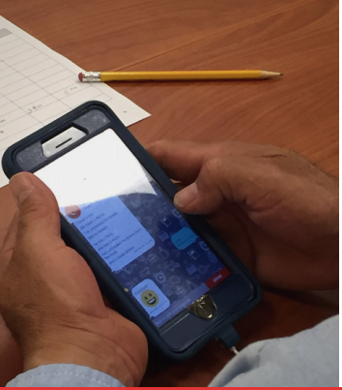
Moving Forward with Mobile Learning
ADD YOUR ORGANIZATION NAME, PARTNERS, LOGOS HERE, AS YOU SEE FIT

Slide 2
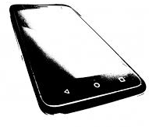
Agenda
What is Team World Ed?
Why mobile learning? Why now?
What is the Adult Literacy XPRIZE and Communities Competition?
Meet the 4 apps
Implementation resources
Tips for smooth onboarding
Questions

Slide 3
Who is Team World Ed?
Workforce development agencies
Community-based programs
Adult ed professional organizations
Family literacy and K12 parent engagement programs
Government and other umbrella agencies
Library-based programs
Volunteer literacy programs
Workplace education programs
www.edtech.worlded.org/team-worlded-xprize
Virtual, growing community of organizations from CT, MA, NH, RI, TX, and VA
Co-sponsored by IDEAL Consortium and New England Literacy Resource Center
@ World Education
Notes:
Team World Ed is a growing, virtual community of adult education programs, funders, and other partners in six states: Connecticut, Massachusetts, New Hampshire, Rhode Island, Virginia, and Texas. Members include adult education programs, libraries, school districts, volunteer literacy tutoring programs, adult education professional development organizations, career centers, workplace education programs, adult education professional associations, and government and other public agencies. Team World Ed is coordinated by the EdTech Center at World Education.
World Education is honored to be a milestone award recipient in the national Adult Literacy XPRIZE Communities Competition. Team World Ed is opening access to learning for adults with low literacy skills using their smart phones. In this competition, friends and family and community members are invited to participate as well and use the free learning apps.

Slide 4
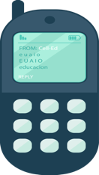
Current Access to Formal Learning and Technology
95%
in US have cell phone
36 million
need literacy help in the U.S.
17%
are simple phones
32 million
will NOT
get help
Data from OECD.org (PIAAC), PewInternet.org
Notes:
The available funding for adult literacy and education cannot accommodate the vast majority of the 36 M low-literate adults in the US.

Slide 5
Why mobile learning?
Increase reach
Accelerate/personalize learning
Extend learning
Support digital literacy & skill development
Notes:
We believe mobile learning has the potential to improve the effectiveness of instruction, accelerate learning, and increase the reach of adult education. Adults will not only improve their literacy and English proficiency but they will also hone their digital learning skills. Digital literacy is essential to economic progress, lifelong learning, and civic participation in our rapidly changing world where automation and technological innovation drive change in every sphere of life.

Slide 6
Why now?
Unprecedented opportunity to access field tested apps designed for low-literacy adults and English Language Learners
Window of opportunity is short: April – August 2019
Notes:
Never before has there been an effort and opportunity like this one or 4 free apps to choose from that have been specifically designed for low-literacy adults.
The apps must be downloaded by August 31 and will then be accessible then for free for another year through Aug 2020.

Slide 7
The Adult Literacy XPRIZE Communities Competition
Challenges communities and organizations to engage low-literacy adults to download and use a free, field-tested mobile learning tool.
Notes:
Funded by the Barbara Bush foundation and Dollar General Literacy Foundation, the Adult Literacy XPRIZE is a two-stage competition to improve access to adult basic education and ESL for adult learners in the united states through mobile learning.
The goal of this competition is to get these field-tested apps to people who can benefit from using them whether they’re enrolled in adult ed programs or not.
In the first stage over 40 app developer teams from around the world competed to develop a literacy app that produced the highest learning gains measured by CASAS for adults who pre-tested below 210 score on CASAS (high-beginning-low intermediate).
We are now at stage 2 which is the Adult Literacy XP Communities Competition.
OPTIONAL (based on your assessment if this is too much or of interest):
The Adult Literacy XPRIZE competition is led and managed by the XPRIZE Foundation. There are 8 challenge competitions happening right now managed by the XPRIZE Foundation. The Adult Literacy competition is one of them. Another one is, for example to develop breakthrough technologies that will convert CO₂ emissions from power plants and industrial facilities into valuable products like building materials.

Slide 8
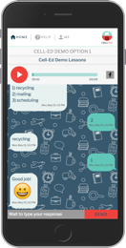
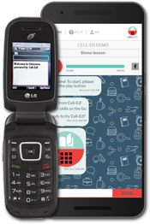
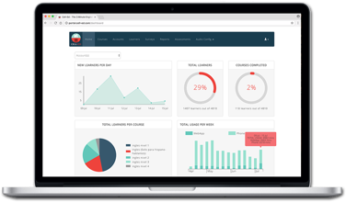
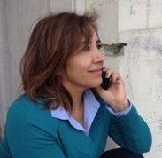
Cell-Ed mobile-first micro-learning platform
teach Micro-lessons assessments certificates+ | engage coaches 2-way messaging | understand surveys analytics customizable
Cell-Ed | mobile-first micro-learning platform
work readiness I work skills | language | literacy | math and more
Notes:
Quick overview of the four apps. Starting with Cell-Ed. Cell-Ed’s micro-learning courses include on-demand coaches. Personalized approach based on each learner’s ability and goals, with coaches on hand to help Combination of audio with back-and-forth messaging most closely mimics one-to-one, conversational-style instruction.

Slide 9
Codex
Game-based
Basic literacy level only; begins with basic letter sounds
abc.xprize.org/pw3366
Notes:
Codex: the Lost Words of Atlantis.
Codex: The Lost Words of Atlantis was developed by People for Words, a team of game designers and literacy experts from Southern Methodist University in TX.
In Codex, players use a computer tablet (codex) found in their attic to translate alien symbols from the lost city of Atlantis into English pronunciation sounds. They travel to interesting locations around the world to uncover the secrets of the lost city of Atlantis.

Slide 10
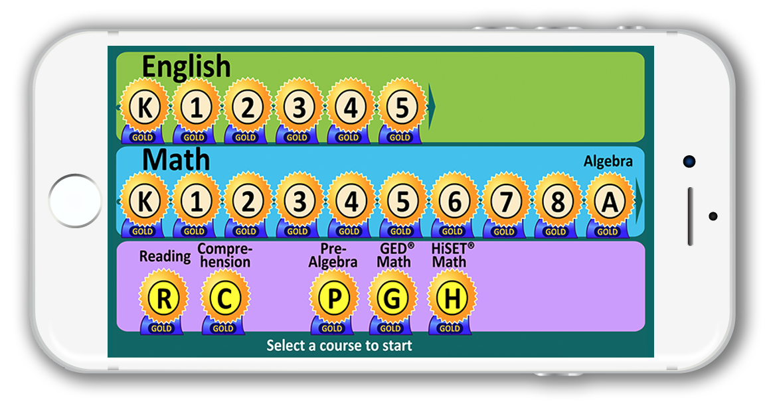
Learning Upgrade
Game-based with songs & videos
Basic literacy level through
HS Equivalency & math
900 + sequenced lessons
Continuous assessment reports available to instructors
https://abc.xprize.org/lu3366

Slide 11
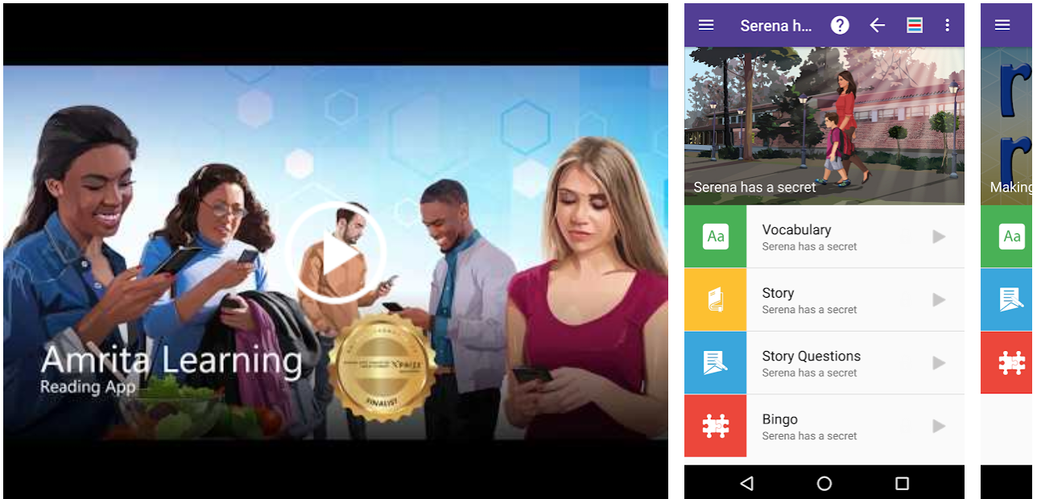
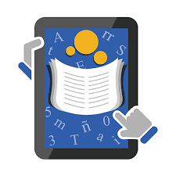
Amrita Learning
Lessons start with learning letter sounds and continue to multi-page stories and articles.
Games linked to lesson vocabulary
Formative and summative assessments with certificates
Online reports available to teams that register at www.amrita.edu/AdultLiteracyXPRIZE
abc.xprize.org/ac3366
Notes:
Vocabulary for each lesson with voice audio support.
Spanish support with audio and translation.
Games linked to lesson vocabulary
Both formative and summative assessments with Certificates
Online reports are available to communities that register at www.amrita.edu/AdultLiteracyXPRIZE

Slide 12
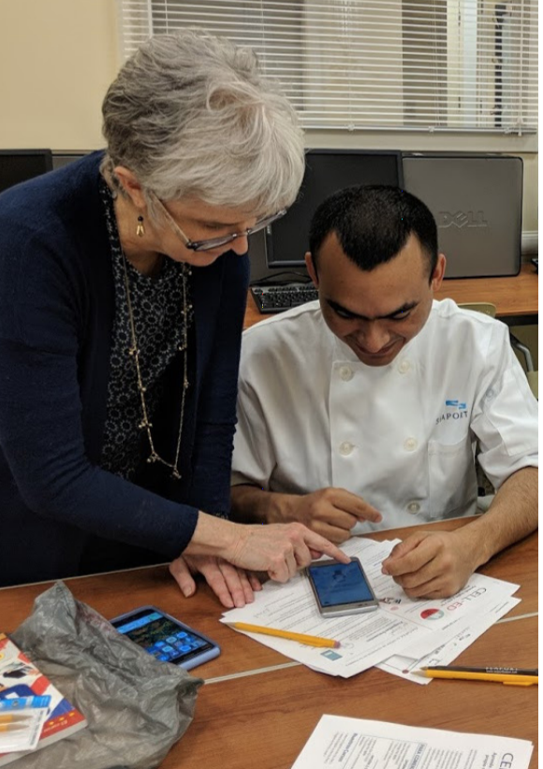
Accessing the Apps
1. Search and download the app(s).
Use Team World Ed code 3366
2. Review the app(s). Choose one or more.
4. Introduce one app to learners/users. Help them download it on a phone or tablet.
5. Point out the app logo so they can find it.
6. Provide a log-in reminder/ wallet card:
www.edtech.worlded.org/team-worlded-xprize
Notes:
4 apps are available for free on Google Play store on Android mobile devices for the competition. So NOT desktop computers or laptops. You are free to use them all or pick fewer, or just one, but we recommend you pick one to begin with.
All four apps have merit and have been field tested with thousands of adult learners, and have resulted in considerable learning gains as measured by CASAS pre and post-tests. They employ varied strategies in how they engage, teach, and support learners. While we do not recommend one app over another, we do recommend you consider the instructional goals of your program and the needs of your end users before selecting the apps that you will promote and use.
.
Provide onboarding support and materials commensurate with the complexity of the registration process; ease of onboarding is essential if users are to persist beyond the initial attempt using an educational technology. All four apps are different. You can find downloadable log-in reminder cards for each app on our website.
Enlist more knowledgeable, tech-savvy learners to help others with limited tech skills having problems navigating the log-in process.
iPhone users can download Learning Upgrade and Cell-Ed for free from the App Store. While that does not count toward the user count in this competition, we encourage you to do that. iPhone users of Learning Upgrade will get the same content as on an Android, which is all of their lessons, including English, math, and GED/HiSET. Only Android users will have access after the competition for an extra year after August 31, 2019.

Slide 13
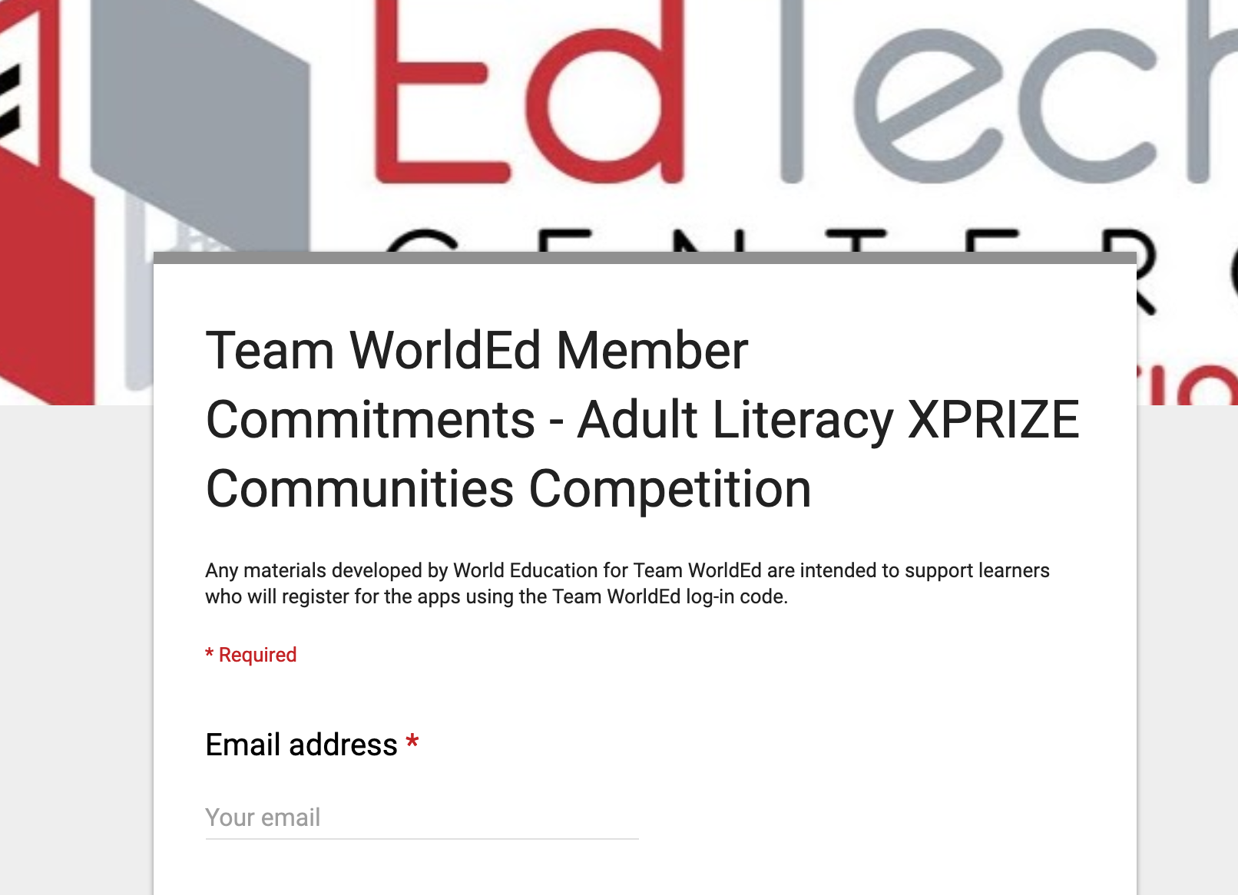
Join the team
to get updates and information about
support webinars
http://bit.ly/team_worlded
Jen_Vanek@worlded.org

Slide 14
Your questions

